Slide 1
Save file in Numpy
Session 13d

Slide 2
Objectives
Save file in NumPy

Slide 3

Save file in Numpy

Slide 4
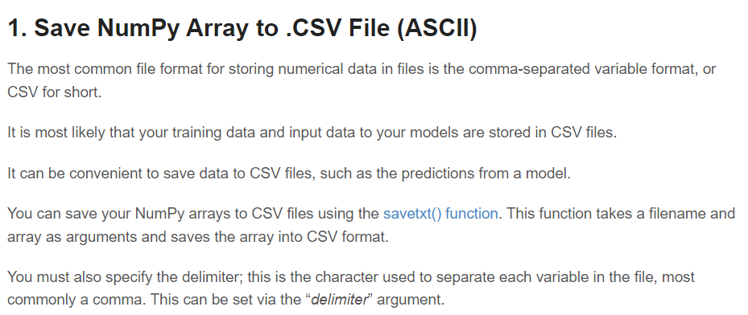
Save file in Numpy

Slide 5
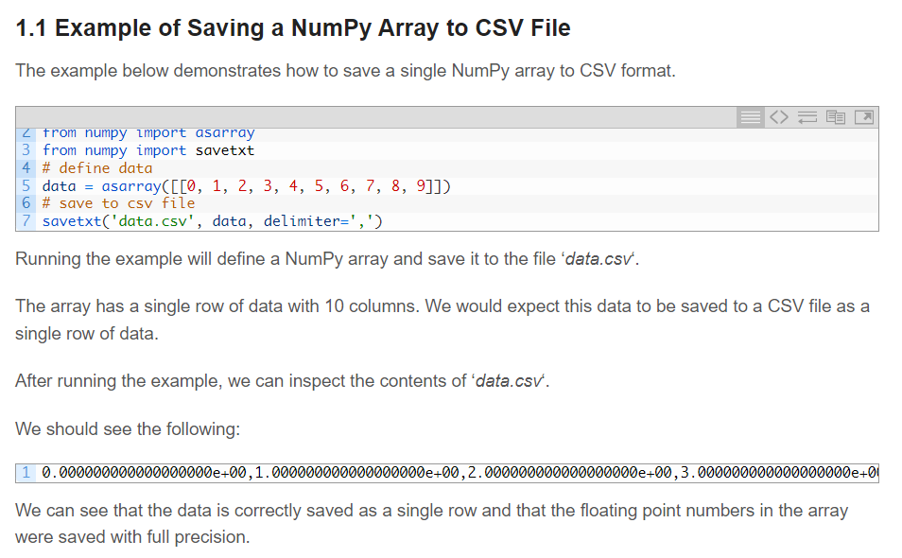
Save file in Numpy

Slide 6
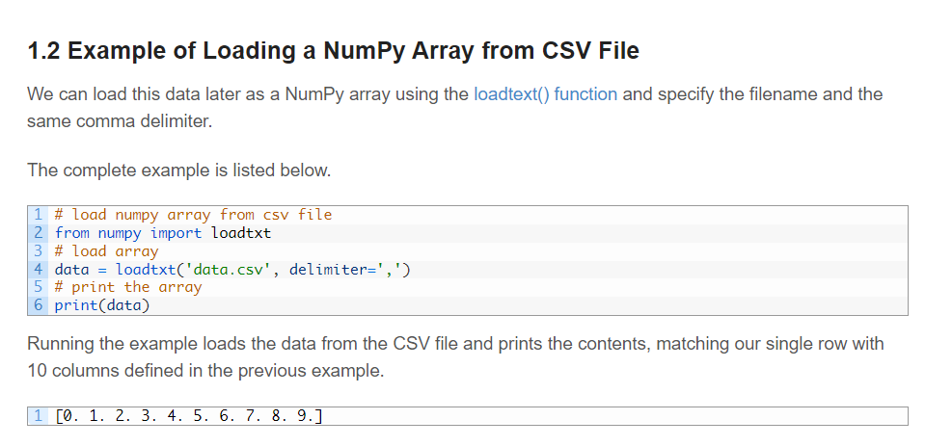
Save file in Numpy

Slide 7

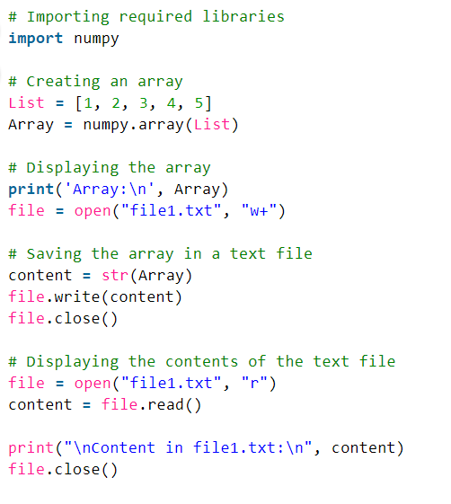
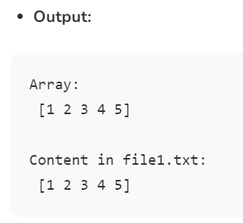
Save file in Numpy

Slide 8
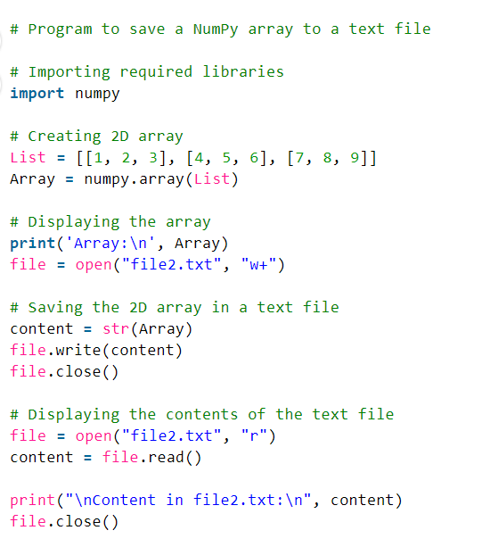
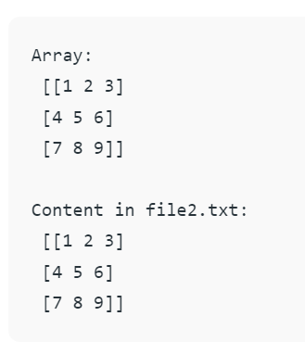
Save file in Numpy

Slide 9
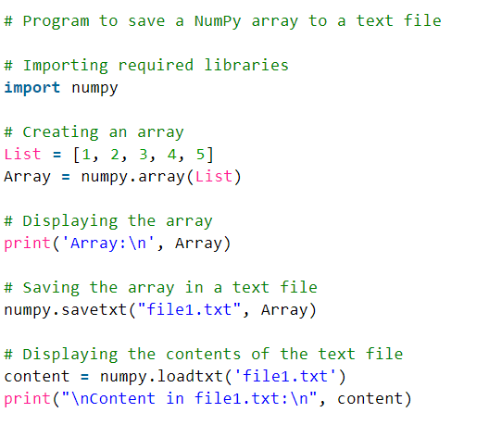
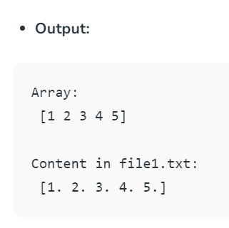
Save file in Numpy

Slide 10
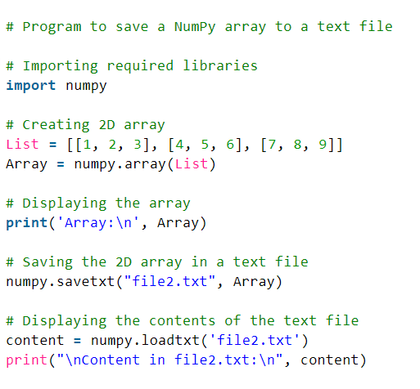
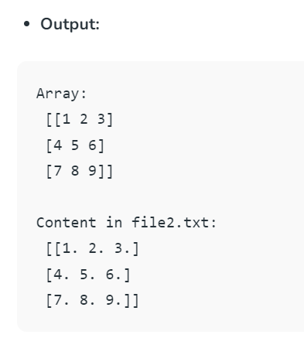
Save file in Numpy

Slide 11
Summary
Save file in NumPy

